Slide 1
Classification of the organ of speech
There are two types of the Organ of Speech
Active Organ of speech
Passive Organ of speech

Slide 2
What is the Active Organ of Speech?
The active organ of speech is the articulator that does all or most of
the movement when a speech is made. The active organ speech is
usually the lower lip or some part of the tongue , because the
tongue and lower lip are free moving.

Slide 3
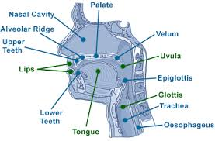
Example of Active articulator
Tongue
The most important active articulator is the tongue
Lower lip
The lower lip is other active articulator.

Slide 4
Please to be continued with my teammate…

Slide 5
Articulator is an organ in the mouth used for making speech such as tongue, mouth or teeth.
organ is a part of the body has a particular purpose
The active articulator is usually the upper jaw, upper teeth, roof of the mouth,

